Slide 1
MeanShift
Chris Kuo, Ph.D.| Columbia University

Slide 2
What is MeanShift?
Statement of the problem
Notes:
This is the question that your experiment answers

Slide 3
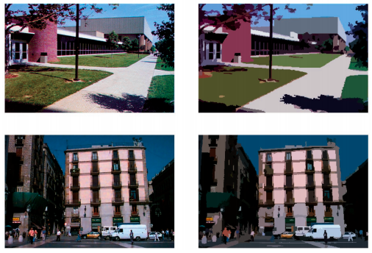
Introduction
First invented in 1975 by Fukunaga and Hostetler but did not gain its popularity until two papers applied the algorithm to Computer Vision.
In contrast to the K-means clustering algorithm, the output of mean shift does not depend on any explicit assumptions on the shape of the point distribution, the number of clusters, or any form of random initialization

Slide 4
How does MeanShift work?
Statement of the problem
Notes:
This is the question that your experiment answers

Slide 5
Kernel density estimation (KDE)
Imagine that the data was sampled from a probability distribution. Kernel density estimation (KDE). Is a method to estimate the underlying distribution.
KDE idea by imagining what the points would do if they all climbed up hill to the nearest peak on the KDE surface. It does so by iteratively shifting each point uphill until it reaches a peak.

Slide 6
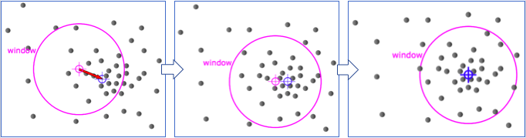
MeanShift - computer vision loves it
Mean shift first finds the centroid of a set of data points.
Secondly it shifts the center of window towards the mean until it converges - thus the name meanshift.
The algorithm iteratively assign each data point towards the closest cluster centroid.

Slide 7
MeanShift - computer vision loves it
This centroid-based approach computes the centroids of various regions in the dataset.
Question: How do we use Mean Shift for outlier detection?
Answer: Data points far from the centroids can be ignored by the clustering process and thus flagged as outliers.

Slide 8
Work cited
Comaniciu

